Slide 1
MET CS 555 – Foundations of Machine Learning Lecture 7: Multiple Linear Regression
Hongsheng Wu
Boston University

Slide 2
Study Guide
Multiple Linear Regression

Slide 3
Multiple Linear Regression

Slide 4
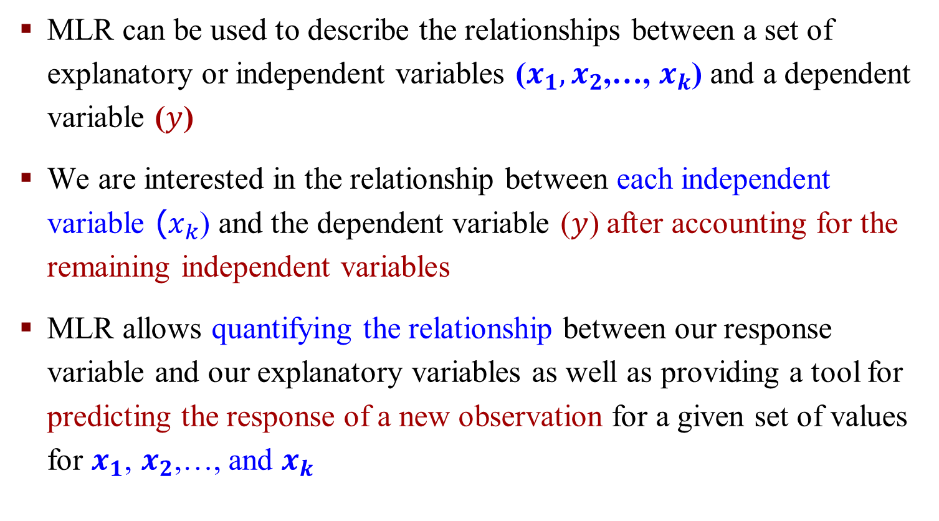
Multiple Linear Regression (MLR)
MLR can be used to describe the relationships between a set of explanatory or independent variables ($x_{1},x_{2}$,…, $x_{k}$) and a dependent variable ($y$)
We are interested in the relationship between each independent variable ($x_{k}$) and the dependent variable ($y$) after accounting for the remaining independent variables
MLR allows quantifying the relationship between our response variable and our explanatory variables as well as providing a tool for predicting the response of a new observation for a given set of values for $x_{1}$, $x_{2}$,…, and $x_{k}$

Slide 5
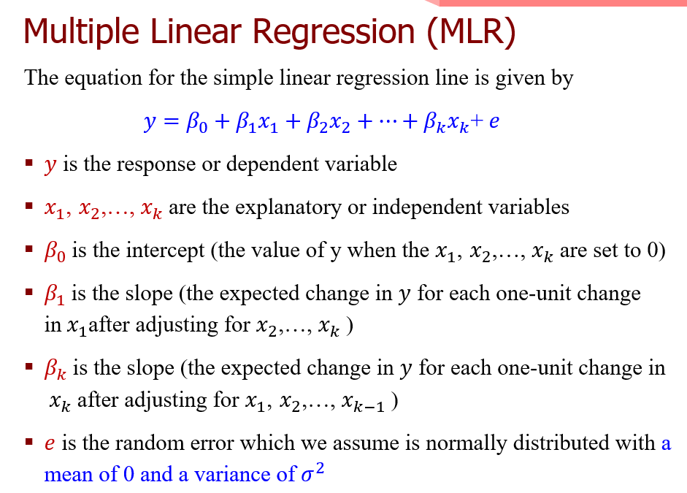
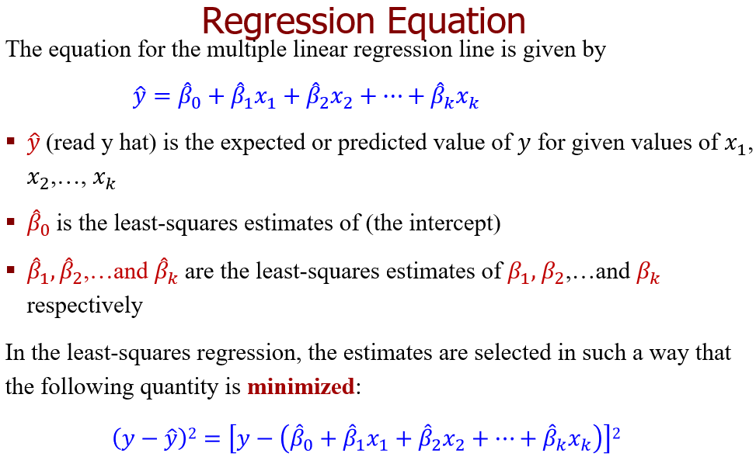
Multiple Linear Regression (MLR)

Slide 6
A MLR Example
In the book Blink by Malcolm Gladwell, Gladwell states that a study of CEOs of Fortune 500 companies found that these individuals tend to be taller than the average US population.
In order to study this phenomenon in more detail and to see if height is associated with increased success in business (as measured by salary), 100 men between the ages of 25 and 65 were polled for their heights (in inches) and annual salaries.

Slide 7
A MLR Example: R Commands – Scatterplot Matrix

Slide 8
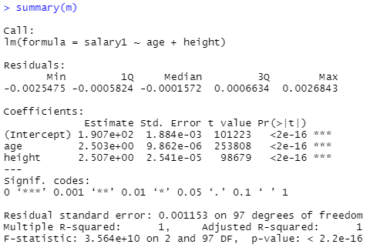
R Command Function
Finding the regression coefficients

Slide 9
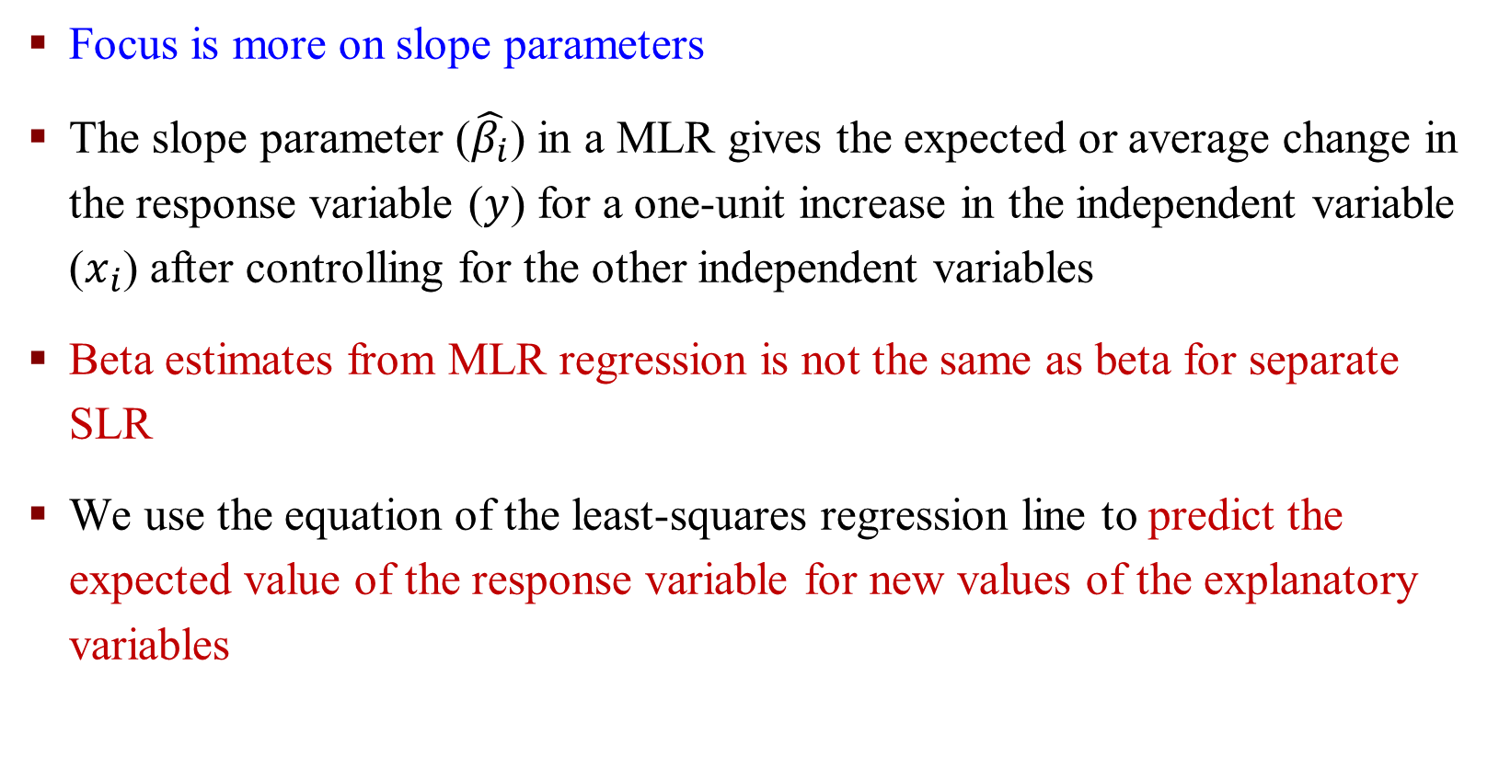
Interpretation of a Regression Equation
$$\hat{y}={\hat{β}}_{0}+{\hat{β}}_{1}x_{1}+{\hat{β}}_{2}x_{2}+…+{\hat{β}}_{k}x_{k}$$
Focus is more on slope parameters
The slope parameter ($\hat{β_{i}}$) in a MLR gives the expected or average change in the response variable ($y$) for a one-unit increase in the independent variable ($x_{i}$) after controlling for the other independent variables
Beta estimates from MLR regression is not the same as beta for separate SLR
We use the equation of the least-squares regression line to predict the expected value of the response variable for new values of the explanatory variables

Slide 10

Interpretation of a Regression Equation
In MLR, the regression line corresponds to a plane ($k = 2$) or a hyperplane ($k > 2$, a k-dimensional plane in a $k+1$-dimensional space).

Slide 11
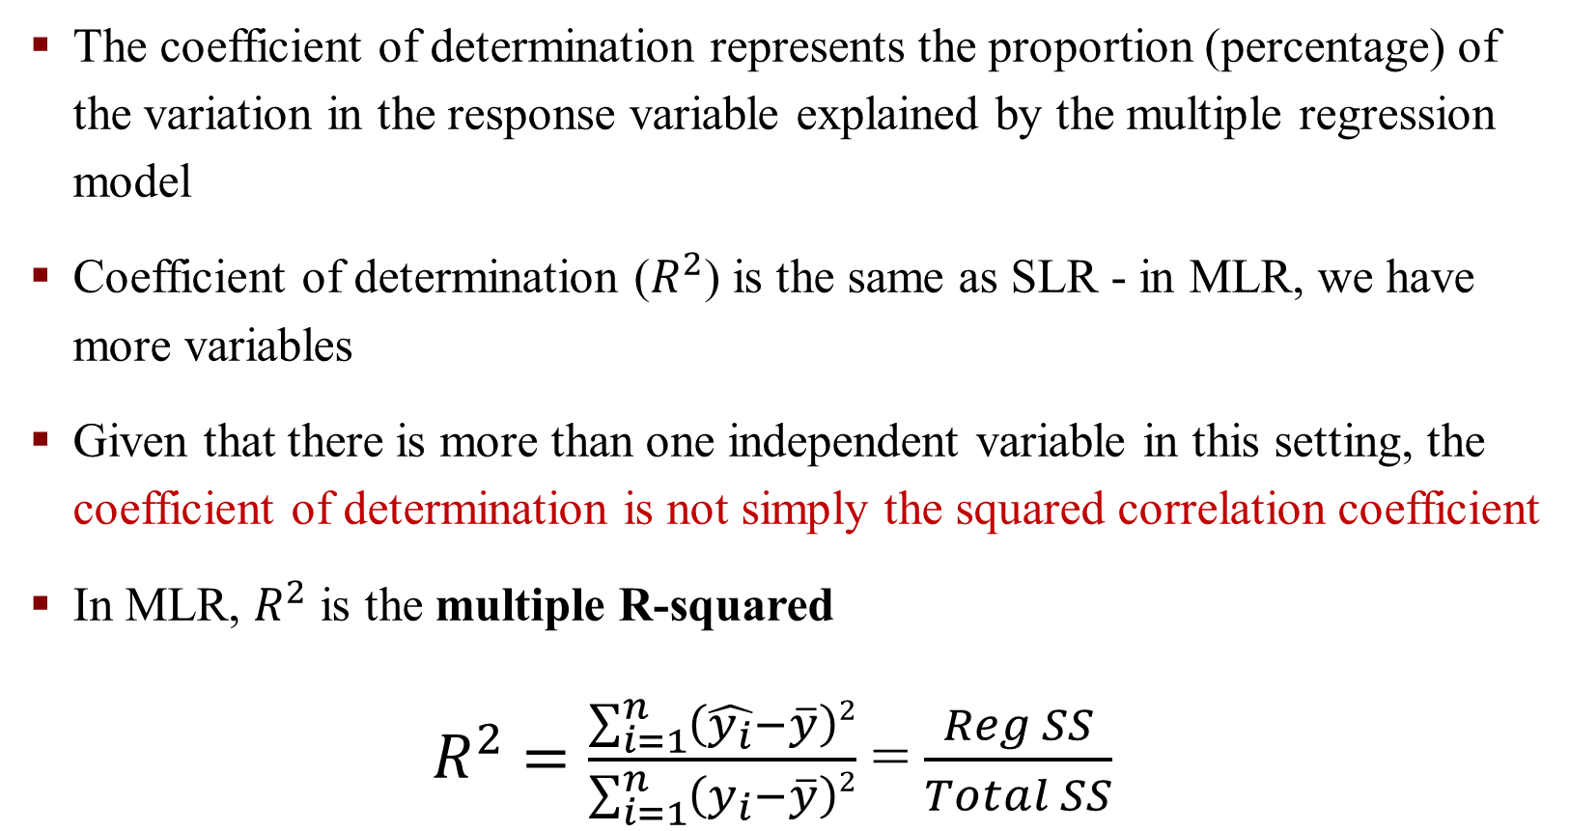
Assessing the Fit of the Regression Line – Coefficient of Determination
The coefficient of determination represents the proportion (percentage) of the variation in the response variable explained by the multiple regression model
Coefficient of determination ($R^{2}$) is the same as SLR - in MLR, we have more variables
Given that there is more than one independent variable in this setting, the coefficient of determination is not simply the squared correlation coefficient
In MLR, $R^{2}$ is the multiple R-squared
$R^{2}=\frac{\sum_{i=1}^{n}{\left(\hat{y_{i}}−\overline{y}\right)2}}{\sum_{i=1}^{n}{\left(y_{i}−\overline{y}\right)2}}$ = $\frac{Reg SS}{Total SS}$
Notes:
Same as SLR R-square

Slide 12
Inference Global F test
We use the ANOVA table and are interested in testing the alternative hypothesis that at least one of the slope parameters is different from 0
If this test confirms that at least one slope parameter is different from 0, then subsequent F-tests or t-tests can be used to assess whether each individual slope parameter is different from 0
In MLR, the F-test for the model is referred to as the global test
The difference to SLR is that, here k > 1. The exact value of k depends on the number of variables in the model.

Slide 13
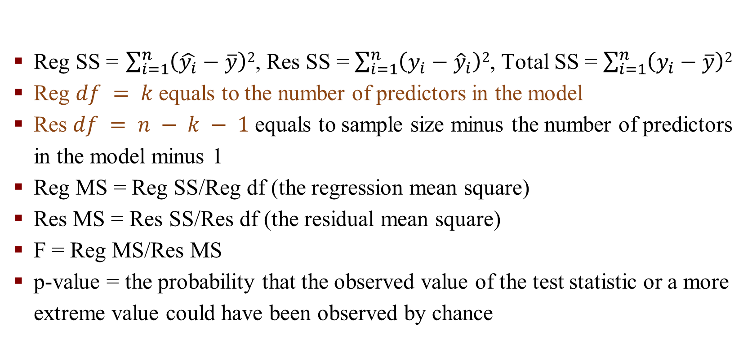
Inference – Anova Table Components
Reg SS = $\sum_{i=1}^{n}{\left(\hat{y_{i}}−\overline{y}\right)2}$, Res SS = $\sum_{i=1}^{n}{\left(y_{i}−{\hat{y}}_{i}\right)2}$, Total SS = $\sum_{i=1}^{n}{\left(y_{i}−\overline{y}\right)2}$
Reg $df = k$equals to the number of predictors in the model
Res $df = n − k − 1$equals to sample size minus the number of predictors in the model minus 1
Reg MS = Reg SS/Reg df (the regression mean square)
Res MS = Res SS/Res df (the residual mean square)
F = Reg MS/Res MS
p-value = the probability that the observed value of the test statistic or a more extreme value could have been observed by chance
Notes:
SS = Sum of Square

Slide 14
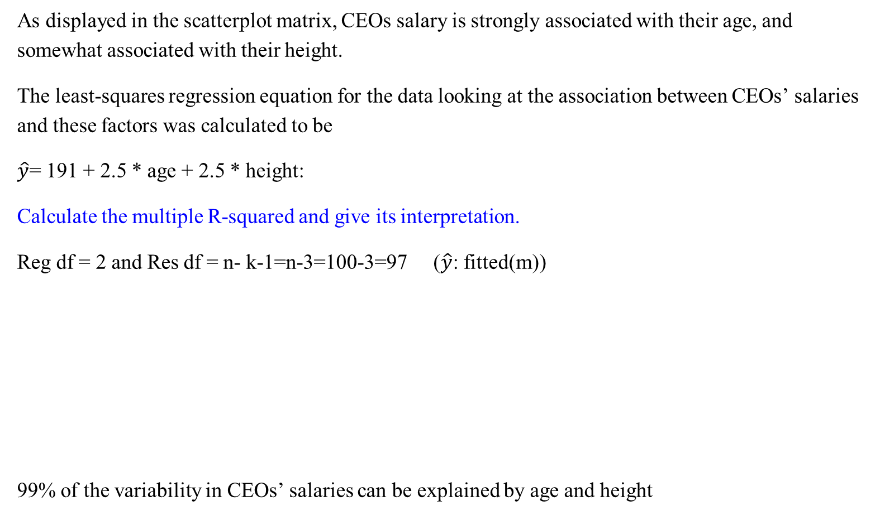
An Example: Calculate R²
As displayed in the scatterplot matrix, CEOs salary is strongly associated with their age, and somewhat associated with their height.
The least-squares regression equation for the data looking at the association between CEOs’ salaries and these factors was calculated to be
$\hat{y}$= 191 + 2.5 * age + 2.5 * height:
Calculate the multiple R-squared and give its interpretation.
Reg df = 2 and Res df = n- k-1=n-3=100-3=97 ($\hat{y}$: fitted(m))
99% of the variability in CEOs’ salaries can be explained by age and height

Slide 15
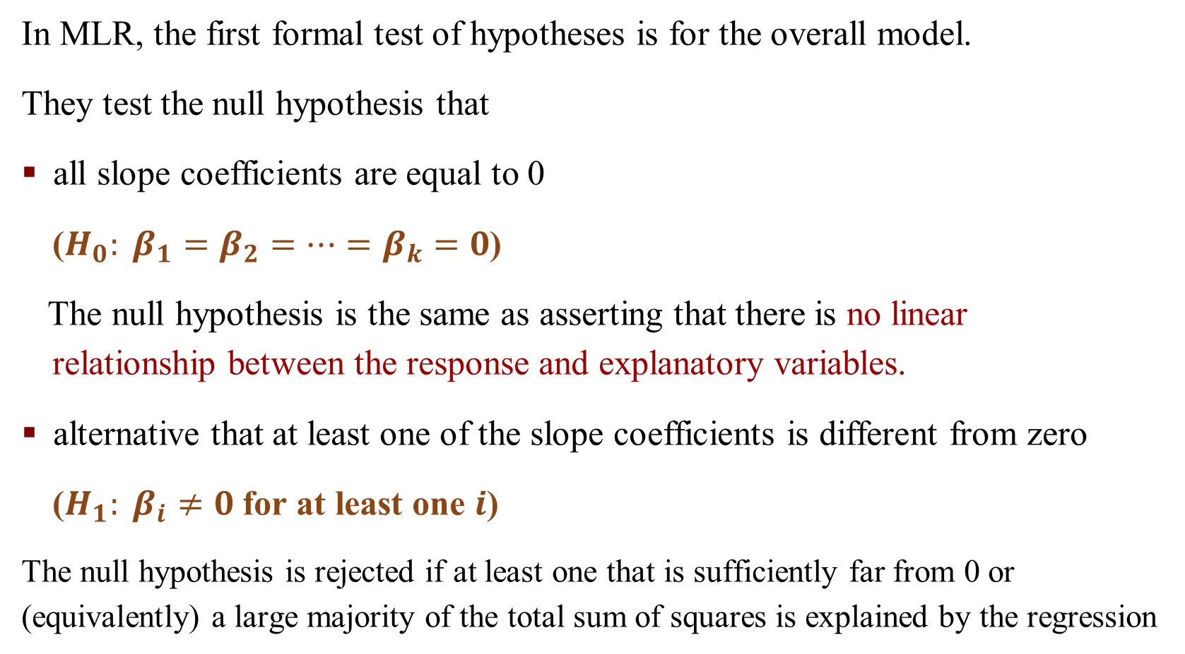
Global F-test
In MLR, the first formal test of hypotheses is for the overall model.
They test the null hypothesis that
all slope coefficients are equal to 0
($H_{0}: β_{1}=β_{2}=…=β_{k}=0$)
The null hypothesis is the same as asserting that there is no linear relationship between the response and explanatory variables.
alternative that at least one of the slope coefficients is different from zero
($H_{1}: β_{i}≠0$ for at least one $i$)
The null hypothesis is rejected if at least one that is sufficiently far from 0 or (equivalently) a large majority of the total sum of squares is explained by the regression

Slide 16
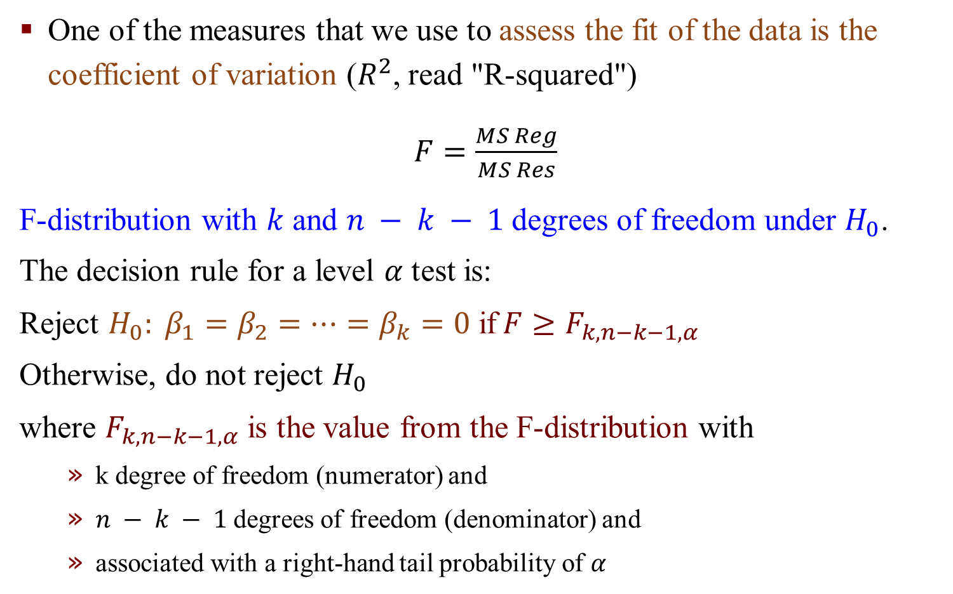
F-test for MLR
One of the measures that we use to assess the fit of the data is the coefficient of variation ($R^{2}$, read "R-squared")
$F=\frac{MS Reg}{MS Res}$
F-distribution with $k$ and $n − k − 1$degrees of freedom under $H_{0}$.
The decision rule for a level $α$ test is:
Reject $H_{0}: β_{1}=β_{2}=…=β_{k}=0$ if$F≥F_{k,n−k−1,α}$
Otherwise, do not reject $H_{0}$
where $F_{k,n−k−1,α}$ is the value from the F-distribution with
k degree of freedom (numerator) and
$n − k − 1$degrees of freedom (denominator) and
associated with a right-hand tail probability of $α$

Slide 17
Quantities from the F-distribution

Slide 18
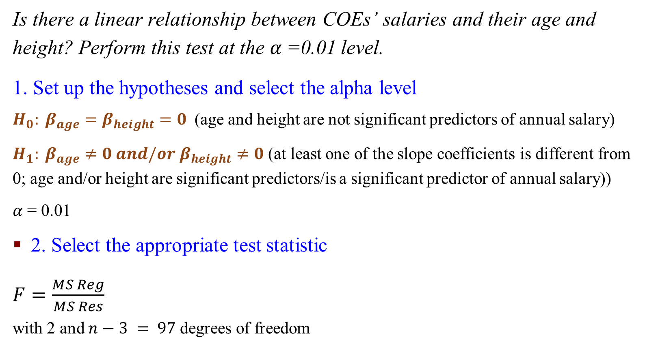
An Example: F-test for MLR
Is there a linear relationship between COEs’ salaries and their age and height? Perform this test at the $α$=0.01 level.
1. Set up the hypotheses and select the alpha level
$H_{0}: β_{age}=β_{height}=0$ (age and height are not significant predictors of annual salary)
$H_{1}: β_{age}≠0 and/{or β}_{height}≠0$ (at least one of the slope coefficients is different from 0; age and/or height are significant predictors/is a significant predictor of annual salary))
$α$ = 0.01
2. Select the appropriate test statistic
$F=\frac{MS Reg}{MS Res}$
with 2 and $n−3 = 97$degrees of freedom

Slide 19

An Example: F-test for MLR
3. State the decision rule
F-distribution with 2, 97 degrees of freedom and associated with $α$ = 0.01 .
$F_{2,97,0.01}$= 4.83
Decision Rule: Reject $H_{0}$ if F $≥$ 4.83
Otherwise, do not reject $H_{0}$

Slide 20
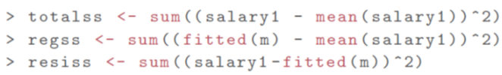
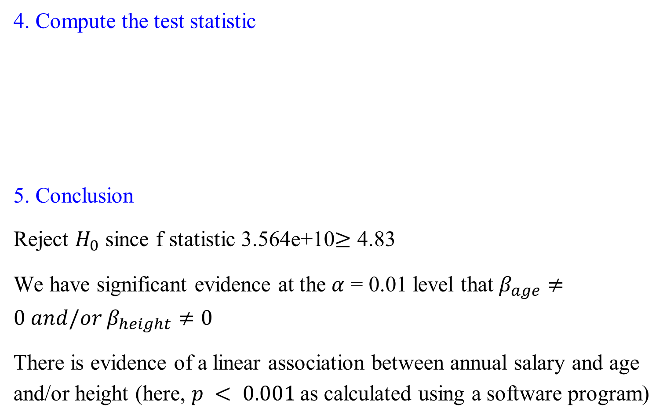
An Example: F-test for MLR
4. Compute the test statistic
5. Conclusion
Reject $H_{0}$ since f statistic 3.564e+10$≥$ 4.83
We have significant evidence at the $α$ = 0.01 level that $β_{age}≠0 and/{or β}_{height}≠0$
There is evidence of a linear association between annual salary and age and/or height (here, $p < 0.001$as calculated using a software program)

Slide 21
Exercise
Test if there is a linear relationship between miles per gallon and average speed, the weight of carrying the load, and percent octane at the α=0.05 level using the ANOVA table we calculated below:
 | SS (Sum of Squares) | df (degrees of freedom) | MS (Mean Square) | F
Regression | Reg SS =2810.06 | Reg df =k=3 | Reg MS =2810.06/3=936.7 | F=Reg MS/Res MS=936.7/24.9=37.6
Residual | Res SS=522.20 | Res df=n−k−1=25−3−1=21 | Res MS=522.20/21=24.9
Total | Total SS = Reg SS + Res SS =3332.26

Slide 22
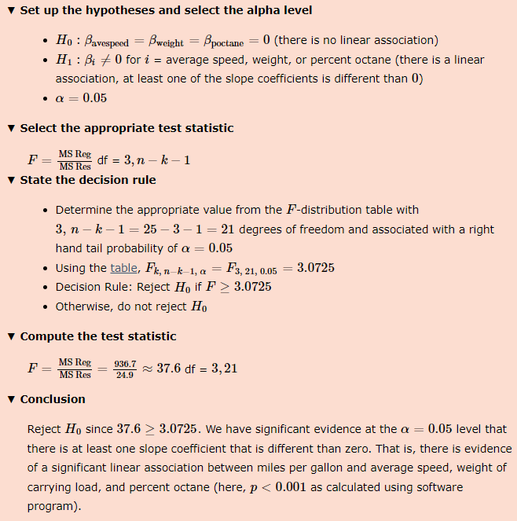

Slide 23
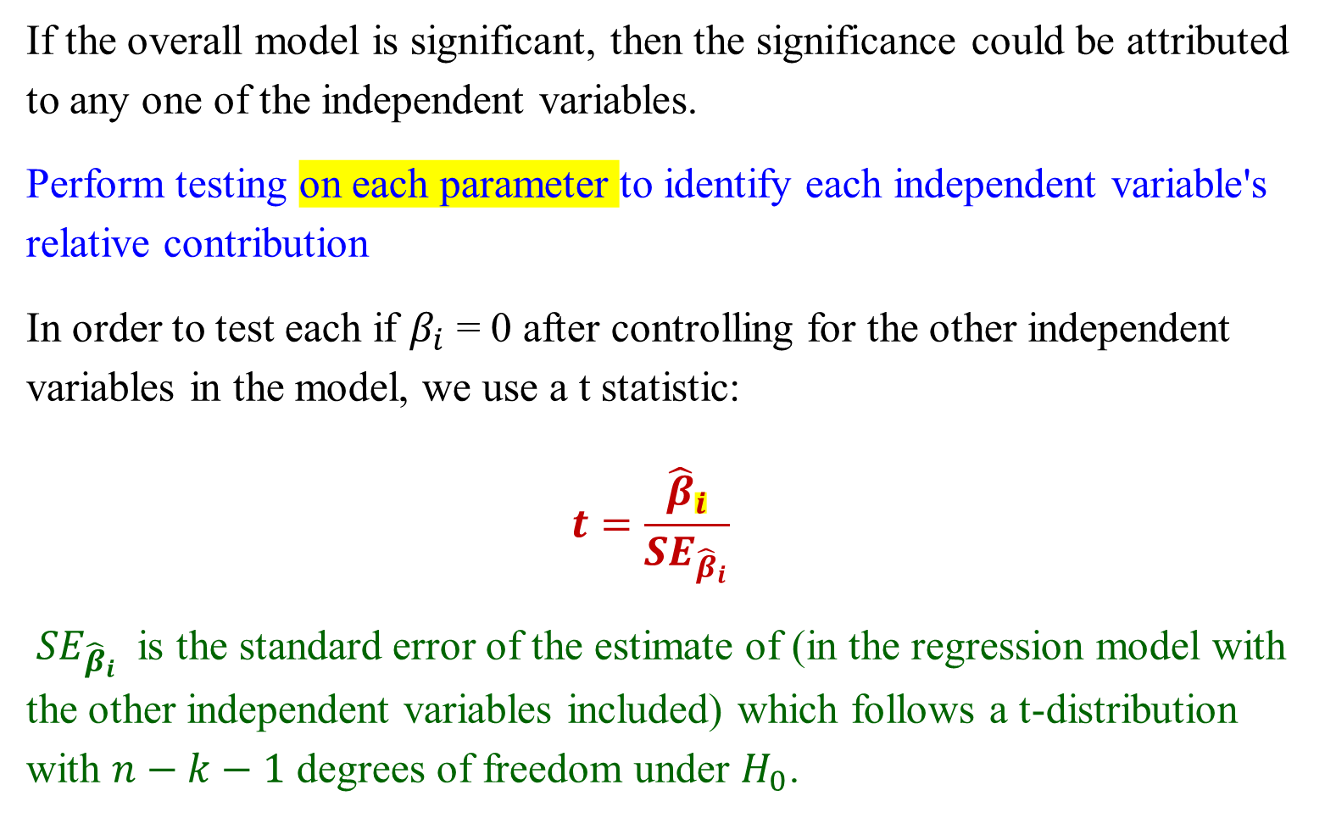
MLR Inference t-test
If the overall model is significant, then the significance could be attributed to any one of the independent variables.
Perform testing on each parameter to identify each independent variable's relative contribution
In order to test each if $β_{i}$ = 0 after controlling for the other independent variables in the model, we use a t statistic:
$$t=\frac{{\hat{β}}_{i}}{{SE}_{{\hat{β}}_{i}}}$$
${SE}_{{\hat{β}}_{i}}$ is the standard error of the estimate of (in the regression model with the other independent variables included) which follows a t-distribution with $n−k−1$ degrees of freedom under $H_{0}$.

Slide 24
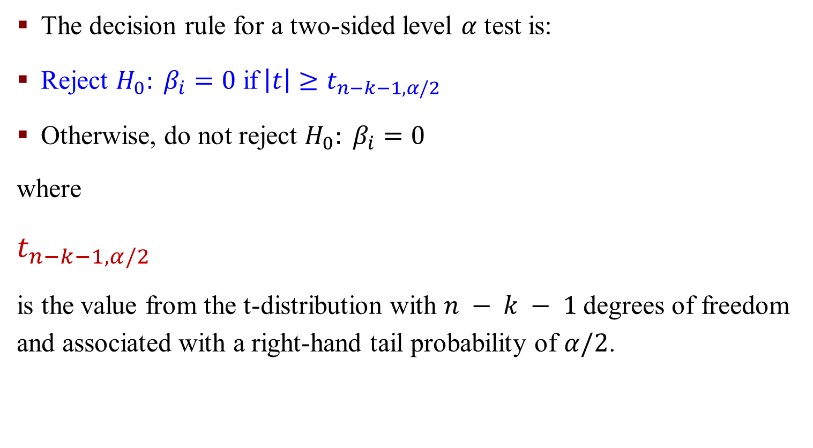
MLR Inference t-test
The decision rule for a two-sided level $α$ test is:
Reject $H_{0}: β_{i}=0$ if$\left|t\right|≥t_{n−k−1,α/2}$
Otherwise, do not reject $H_{0}: β_{i}=0$
where
$$t_{n−k−1,α/2}$$
is the value from the t-distribution with $n − k − 1$degrees of freedom and associated with a right-hand tail probability of $α/2$.

Slide 25
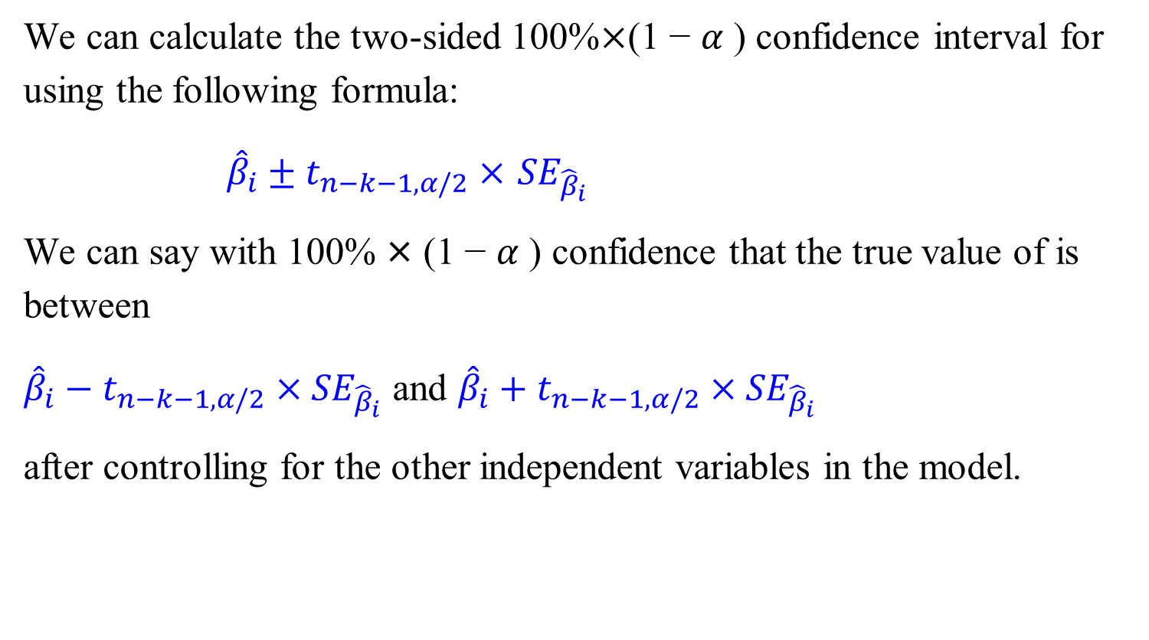
MLR Inference t-test Confidence Interval
We can calculate the two-sided 100%$×$(1 − $α$ ) confidence interval for using the following formula:
${\hat{β}}_{i}±t_{n−k−1,α/2}×$ ${SE}_{{\hat{β}}_{i}}$
We can say with 100% × (1 − $α$ ) confidence that the true value of is between
${\hat{β}}_{i}−t_{n−k−1,α/2}×$ ${SE}_{{\hat{β}}_{i}}$ and ${\hat{β}}_{i}+t_{n−k−1,α/2}×$ ${SE}_{{\hat{β}}_{i}}$
after controlling for the other independent variables in the model.

Slide 26
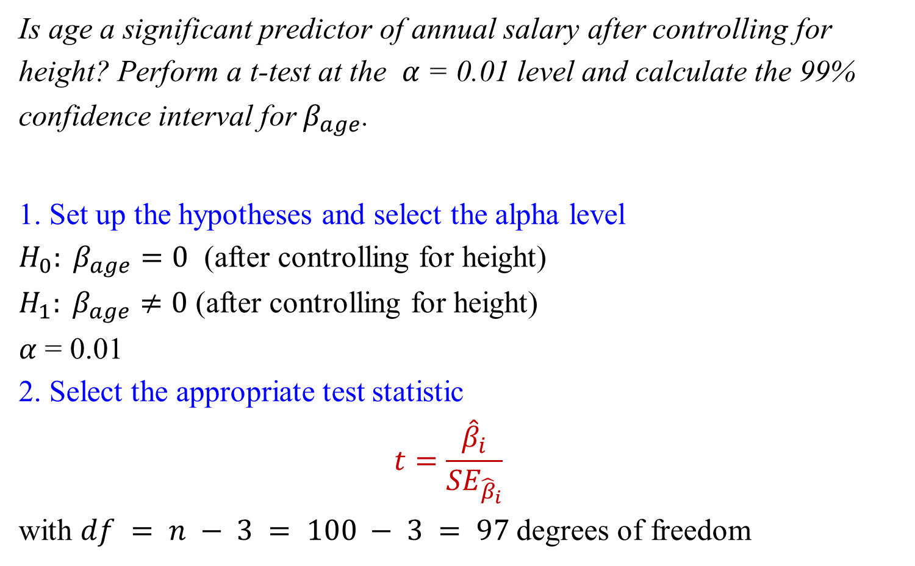
An Example: t-test for MLR
Is age a significant predictor of annual salary after controlling for height? Perform a t-test at the $α$= 0.01 level and calculate the 99% confidence interval for${ β}_{age}$.
1. Set up the hypotheses and select the alpha level
$H_{0}: β_{age}=0$ (after controlling for height)
$H_{1}: β_{age}≠0$ (after controlling for height)
$α$ = 0.01
2. Select the appropriate test statistic
$$t=\frac{{\hat{β}}_{i}}{{SE}_{{\hat{β}}_{i}}}$$
with $df = n − 3 = 100 − 3 = 97$degrees of freedom
Notes:
T-test for every individual predictor

Slide 27
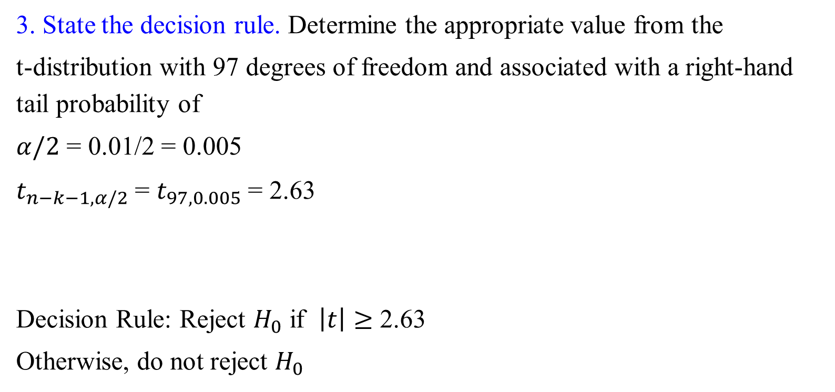
An Example: t-test for MLR
3. State the decision rule. Determine the appropriate value from the
t-distribution with 97 degrees of freedom and associated with a right-hand tail probability of
$α/2$ = 0.01/2 = 0.005
$t_{n−k−1,α/2}$= $t_{97,0.005}$ = 2.63
Decision Rule: Reject $H_{0}$ if $\left|t\right|≥$ 2.63
Otherwise, do not reject $H_{0}$

Slide 28
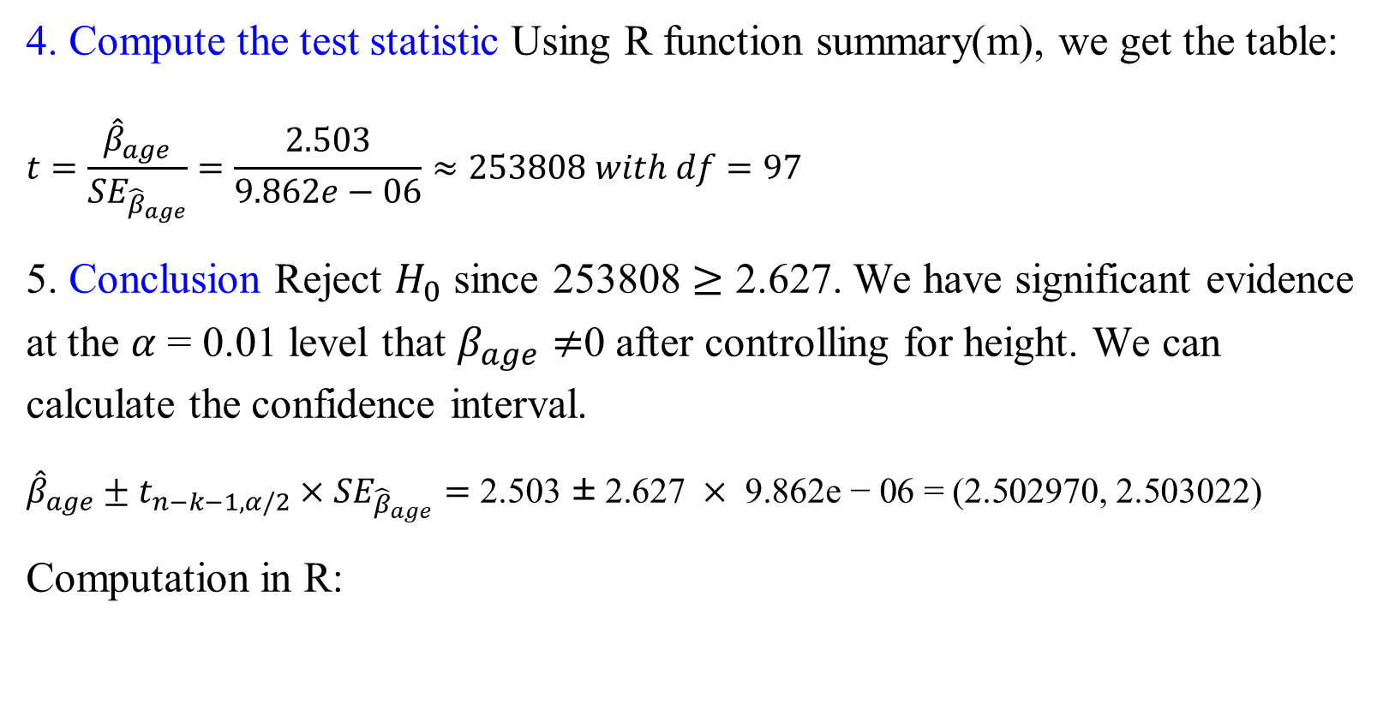
An Example: t-test for MLR
4. Compute the test statistic Using R function summary(m), we get the table:
$$t=\frac{{\hat{β}}_{age}}{{SE}_{{\hat{β}}_{age}}}=\frac{2.503}{9.862e−06}≈253808 with df=97$$
5. Conclusion Reject $H_{0}$ since 253808 $≥$ 2.627. We have significant evidence at the $α$ = 0.01 level that $β_{age}≠$0 after controlling for height. We can calculate the confidence interval.
${\hat{β}}_{age}±t_{n−k−1,α/2}×$ ${SE}_{{\hat{β}}_{age}}=\text{2}\text{.}\text{503 ± 2}\text{.}\text{627 }×\text{ 9}\text{.}\text{862}\text{e}\text{ − 06 = (2.502970, 2.503022)}$
Computation in R:

Slide 29
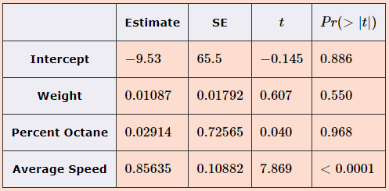
Exercise
Is the weight of the carrying load a significant predictor of miles per gallon after controlling for percent octane and average speed? Perform a t-test at the α=0.05 level. Use the output in the table below to address this question.
Using the data we collected on the 25 trips, a multiple linear regression model was calculated, predicting miles per gallon from average speed using the weight of carrying the load. The summary of the output of the model is below
Notes:
3 parameters

Slide 30
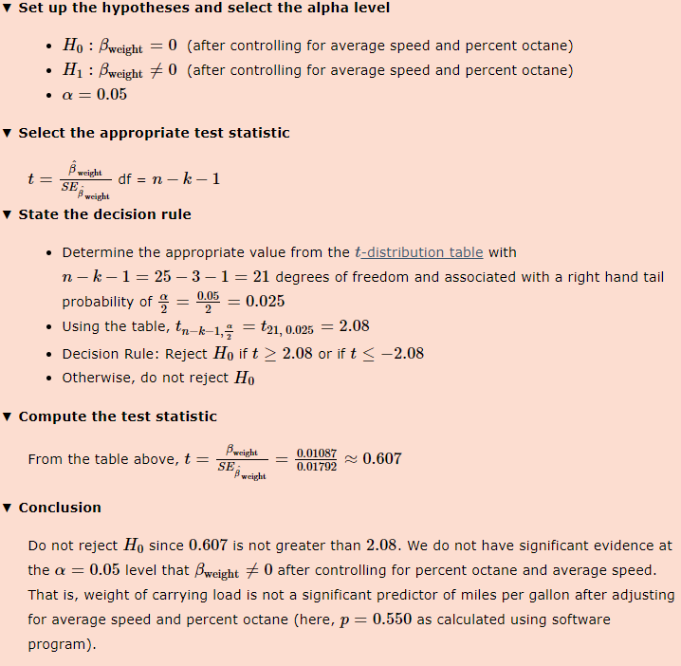

Slide 31
R examples
Creating a Scatterplot Matrix
Example CEOs Salary and correlation with age and height
> data <- read.csv("CEO_salary.csv")
> attach(data)
> salary1 <- salary/1000
> data1 <- data.frame(age, height, salary1)
> cor(data1)
> pairs(data1)

Slide 32
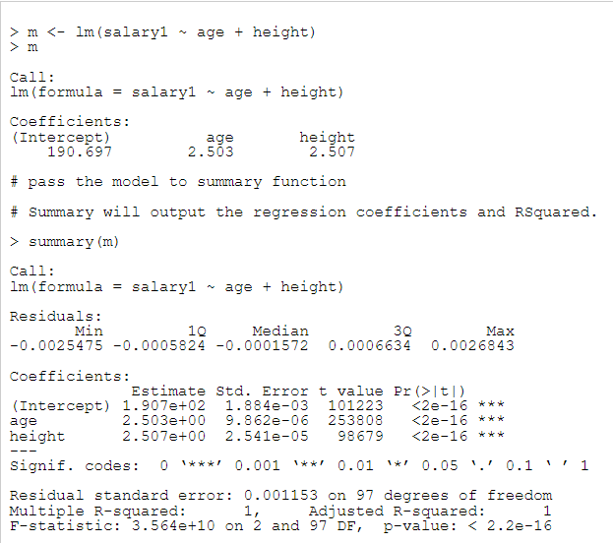
Build a multiple linear regression model

Slide 33
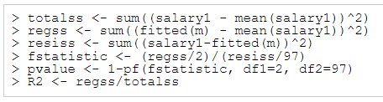
Manual Calculation of Rsquared

Slide 34
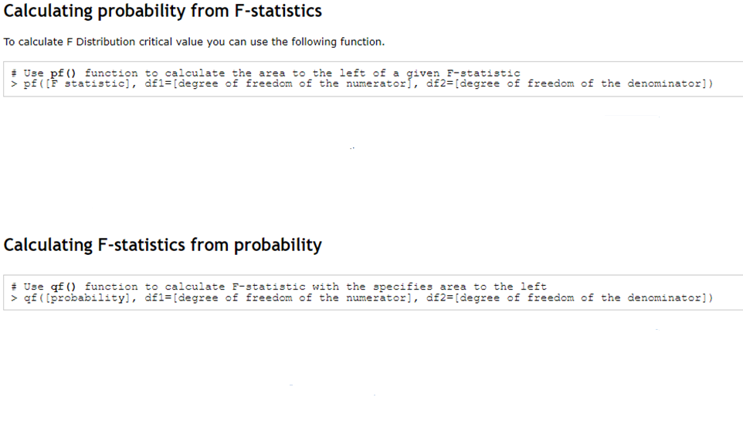


R Command: F Distribution

